Slide 1
INCREMENT 2
AUGMENTED REALITY
FURNITURE ADVERTISING
SAMHITHA
SWATI
ZEENAT
KHUSHAL

Slide 2
EXISTING WORK
There are similar apps like TheMine, IKEA and Amazon shopping which are the used for the advertising of the furniture.
Ours is a similar application which scans the marker and displays the furniture on it.
We are also planning to use the speech to text recognition in our project which would help the disabled people as well.

Slide 3
INTRODUCTION TO THINGWORX
ThingWorx studio is a latest tool for Augmented Reality which helps the developers to develop AR applications with ease. It helps us to build AR apps irrespective of the platform which provides advantage to the companies to advertise their product. We don’t need to write lengthy lines of code for the implementation using this tool.
The major advantages of using this tool are:
Cost reduction
Easy to use
Platform independent
Supports the access on multiple devices.
Also enables to build animations.
It can be used for IoT data as well.

Slide 4
PROCEDURE
Creating an account on Thingworx studio
Installing it on the laptop
Configuring the tool
Creating AR Project
Connecting server to the network
Importing 3d object using grabcad.com
Creating 2d widgets and binding them to the code
Saving , previewing and publishing
Deploying

Slide 5
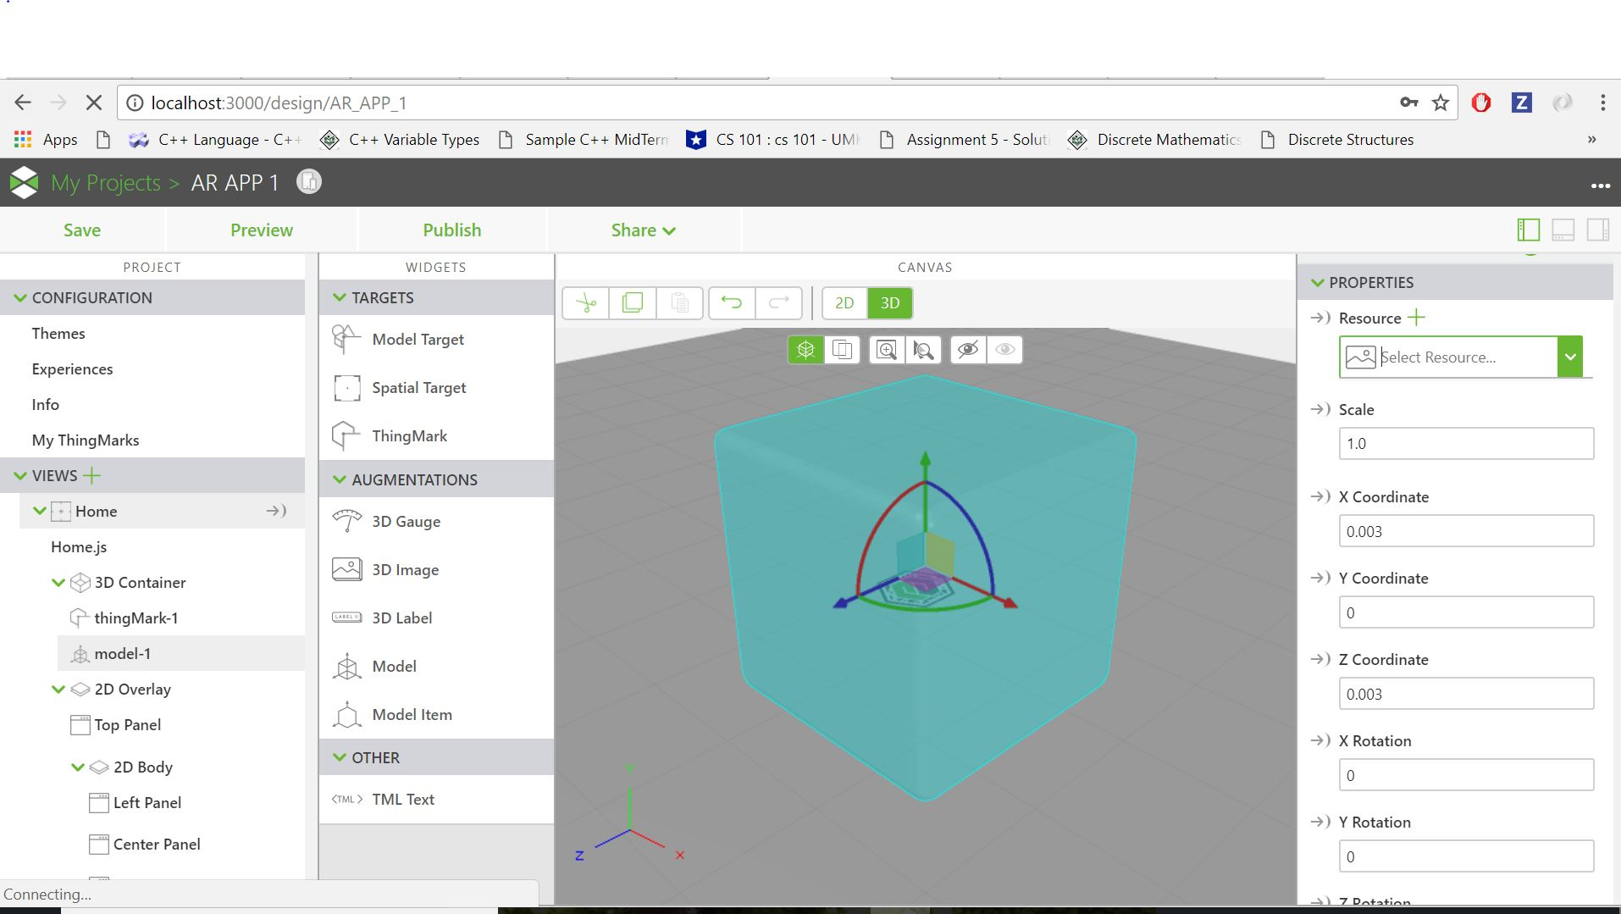
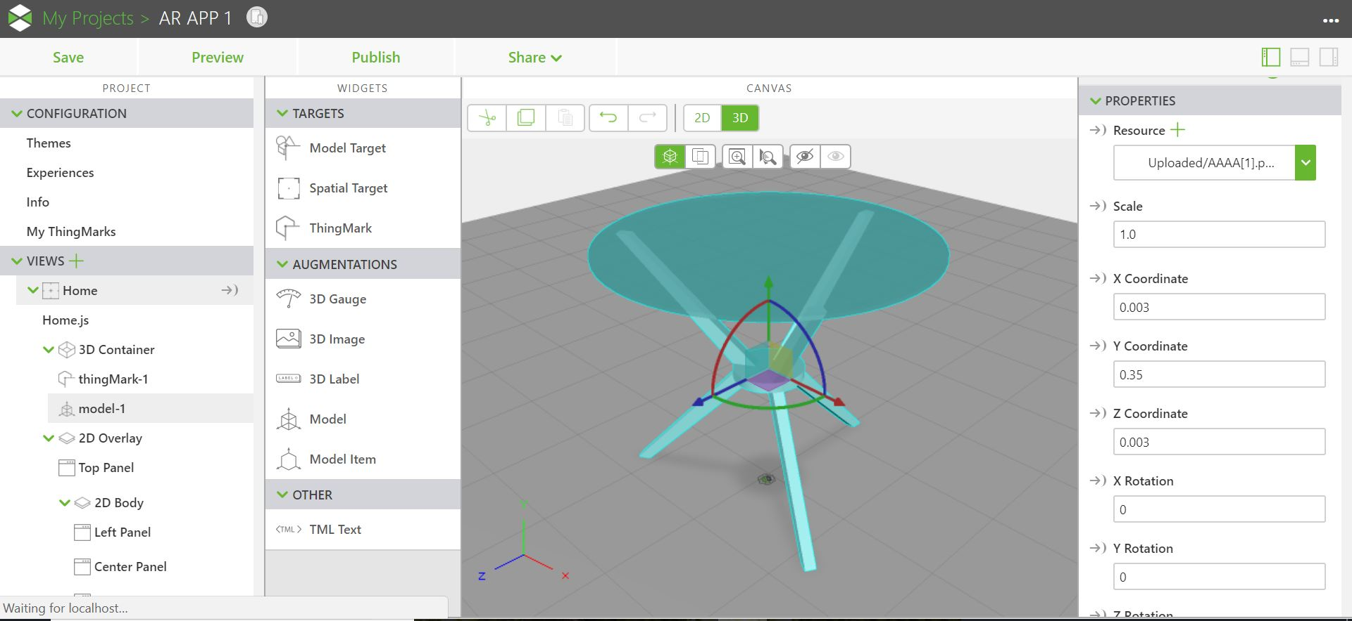
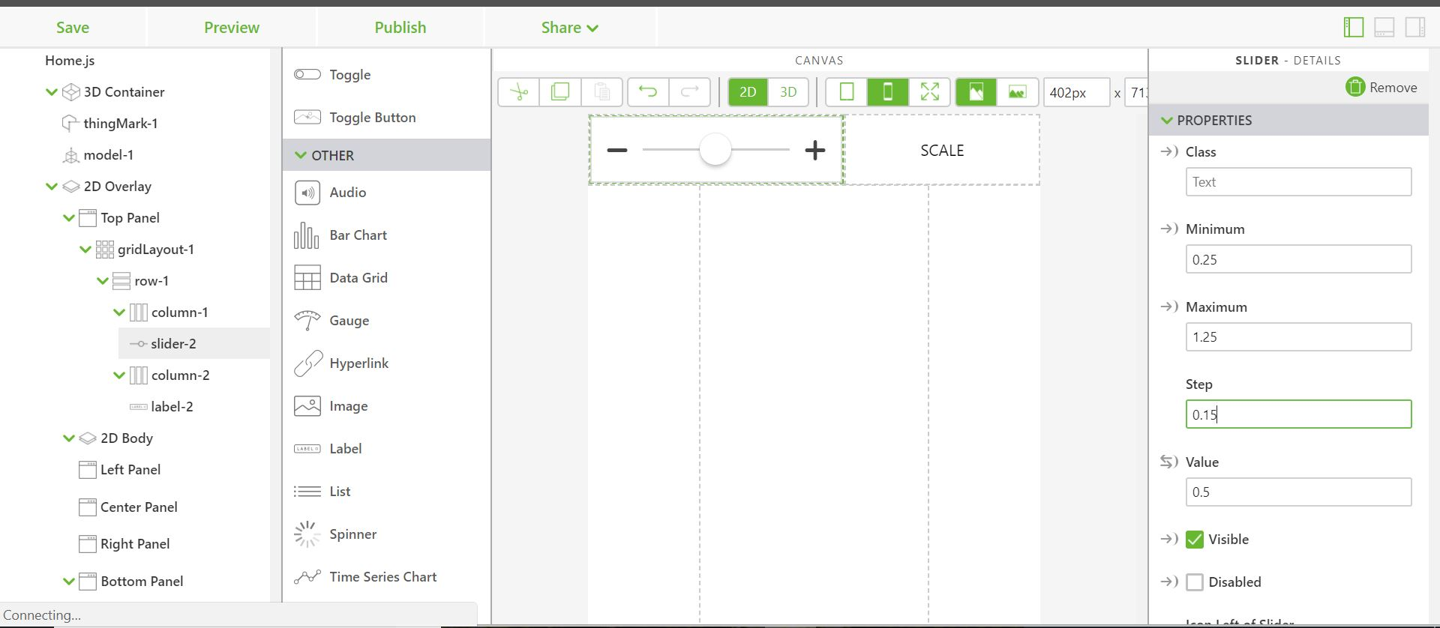

Slide 6
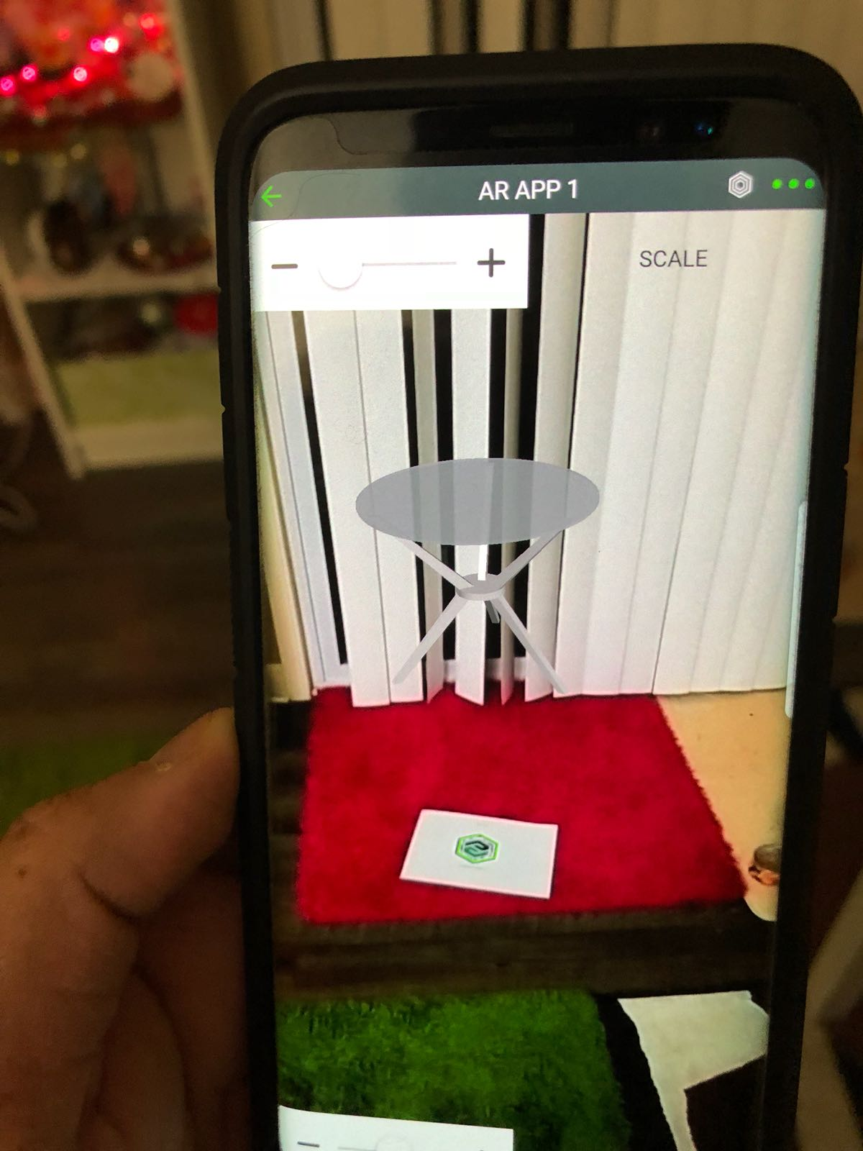
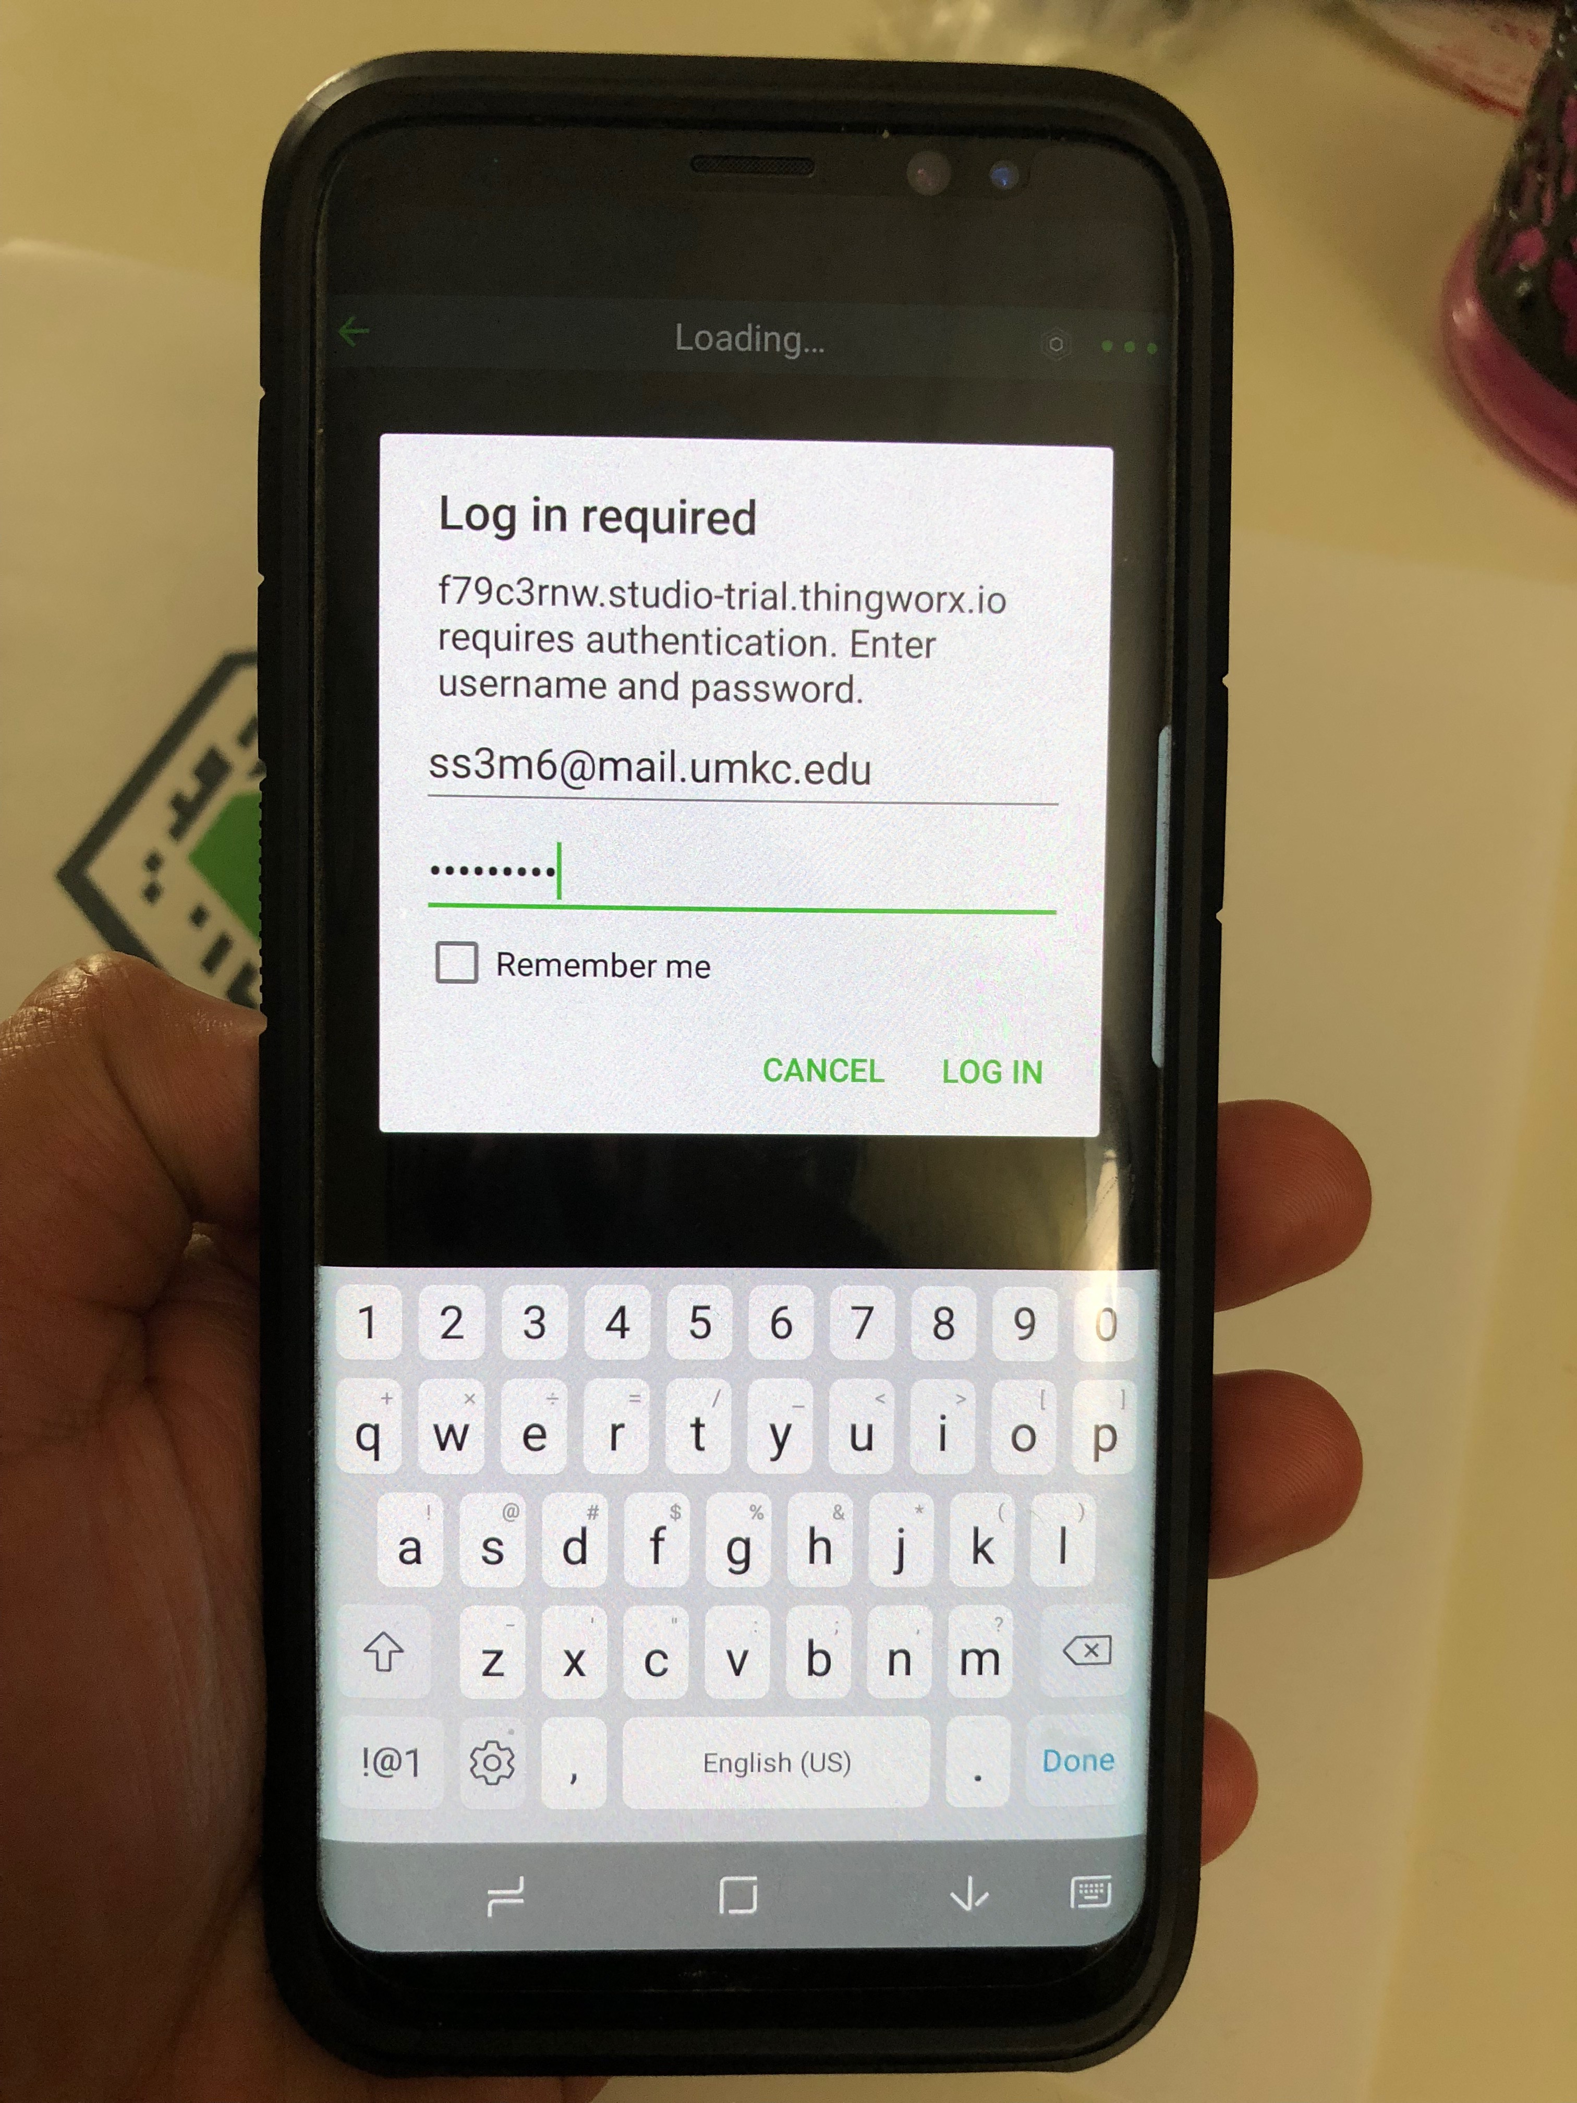
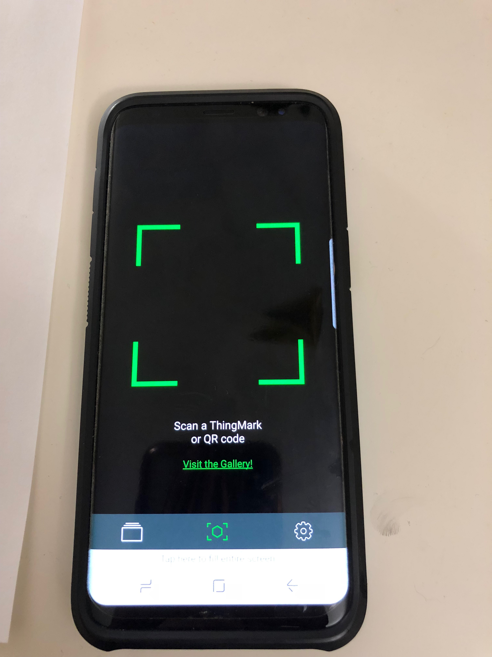
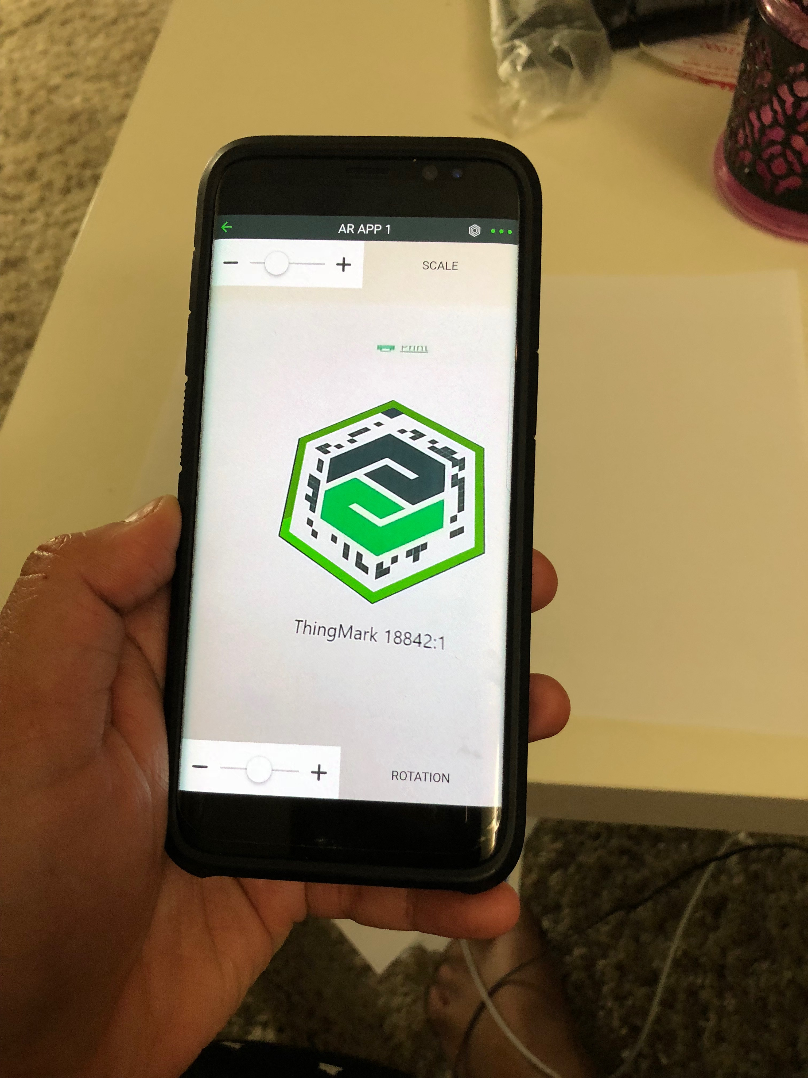
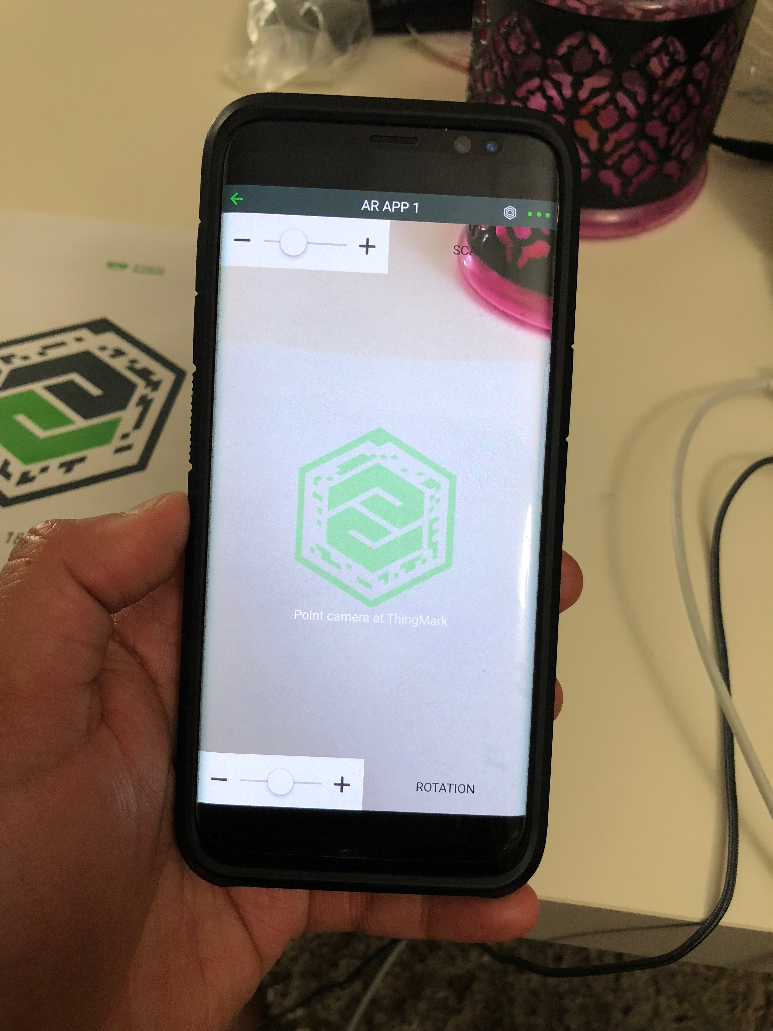
IMPLEMENTATION ON PHONE

Slide 7
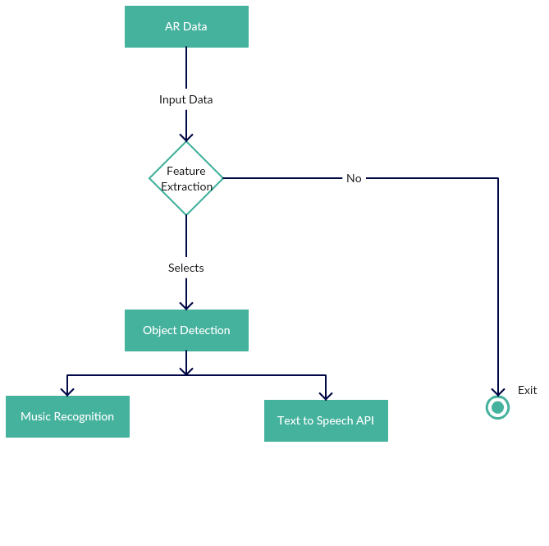
WorkFlow

Slide 8
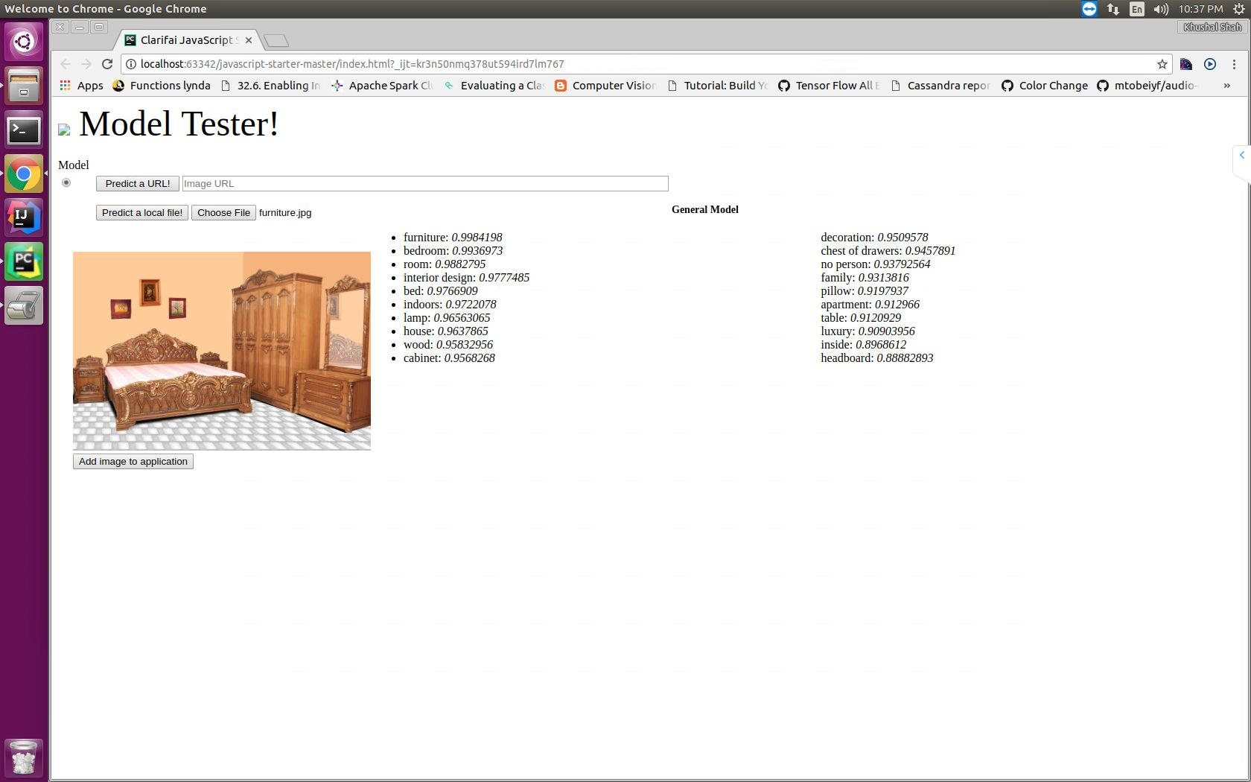
Model Testing

Slide 9
Work Completed
Designing of Web page using HTML 5
Accomplished with Clarifai API
Extraction of features from image
Work to be completed
Putting extracted features in meaningful sentence
Speaking out the sentence using speech API
Music recognition based on color feature

Slide 10
Thank You

